Slide 1
Nexperia Image Classification
HE, Changxiang
XU, Yan

Slide 2

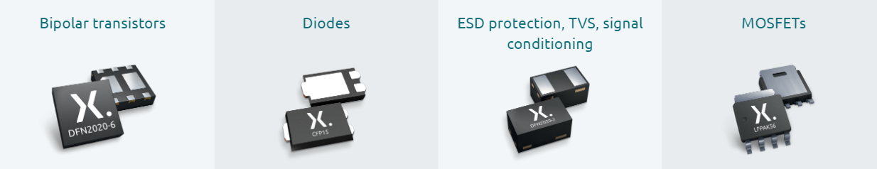
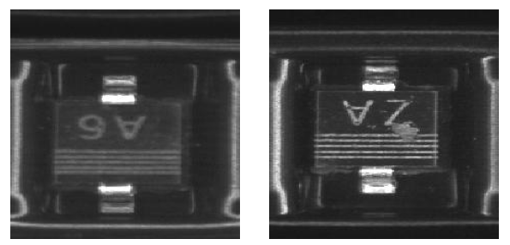
Background and introduction
The good semi-conductor (left) and defect semi-conductor (right)
Notes:
Nexperia (https://www.nexperia.com/) is one of the biggest Semi-conductor company in the
world. They produce billions of semi-conductors every year. Meanwhile, a lot of unqualied devices
are mixed with the good ones. Mass production makes it dicult for human workers to examine
all of the products. Therefore, we would like to use modern machine learning methods, particularly
deep learning, to help Nexperia pick out as many defect devices as possible while preserving the
good ones, thus improving their yield rate.

Slide 3
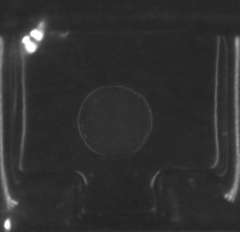
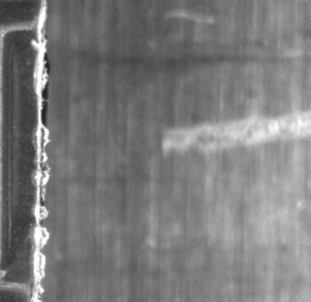
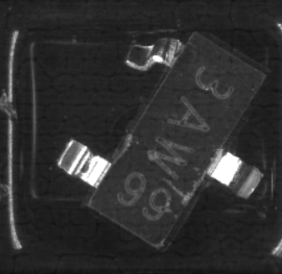
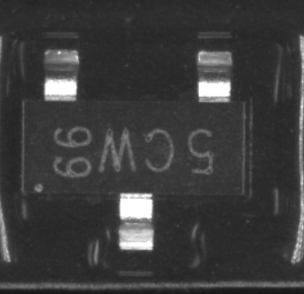
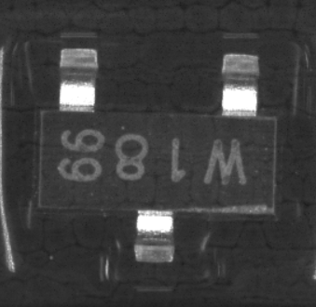
Background and introduction
The good semi-conductor
The defect semi-conductors
Notes:
Nexperia (https://www.nexperia.com/) is one of the biggest Semi-conductor company in the
world. They produce billions of semi-conductors every year. Meanwhile, a lot of unqualied devices
are mixed with the good ones. Mass production makes it dicult for human workers to examine
all of the products. Therefore, we would like to use modern machine learning methods, particularly
deep learning, to help Nexperia pick out as many defect devices as possible while preserving the
good ones, thus improving their yield rate.

Slide 4

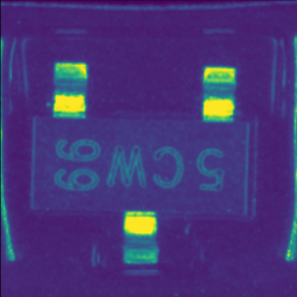
Data preparation
18*18 image size
224*224 image size
Notes:
the 18*18 image is not accurate enough to show all the details of an image and may decline the classification accuracy. On the contrary, 224*224 image size is accurate enough to show every detail of the semiconductor device.

Slide 5
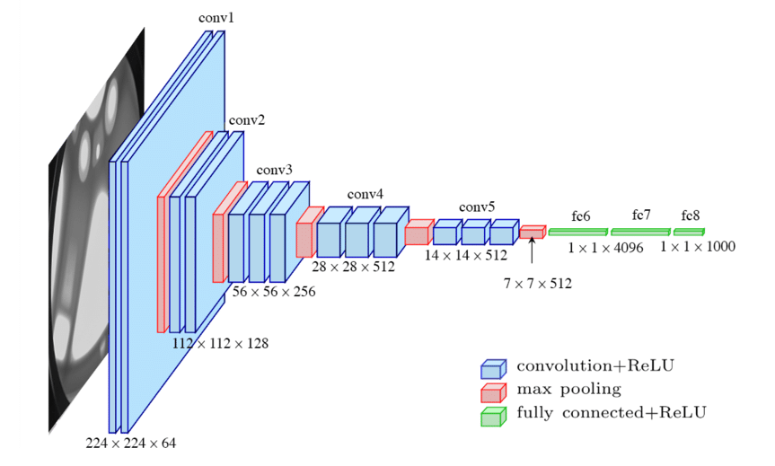
Methodology
Optimizer = SGD methods
Loss function = BCEloss
The architecture of VGG16
Notes:
Thus VGG16 network is applied to buildup the learning model. the images are resized to 224*224 and converted from the grayscale image to the RGB image to fit the input size of VGG16 before we input the images to the next work. Different batch sizes and learning rates are studied to modify the training process. According to the references, larger batch sizes often obtain higher performance.

Slide 6
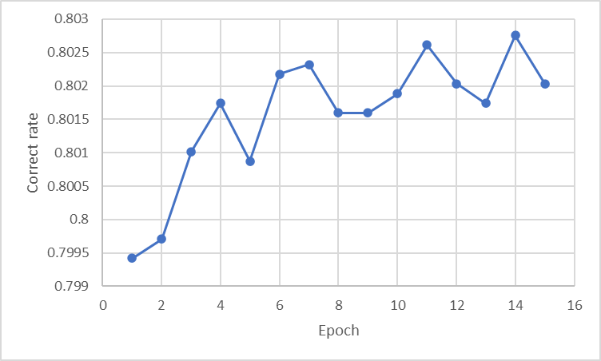
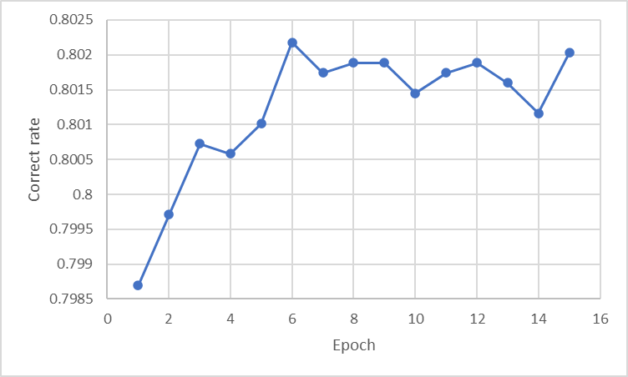
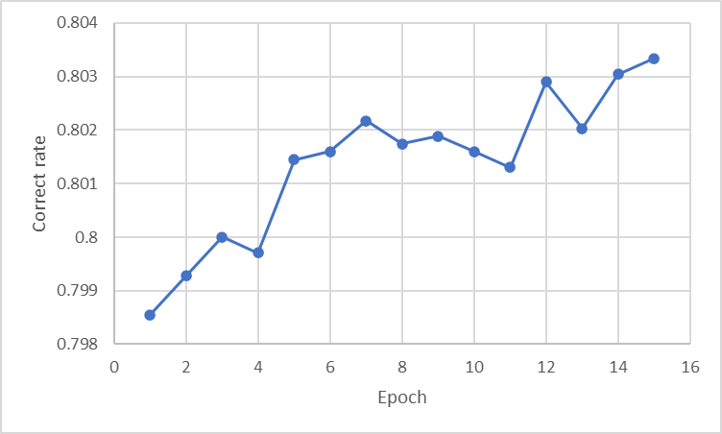
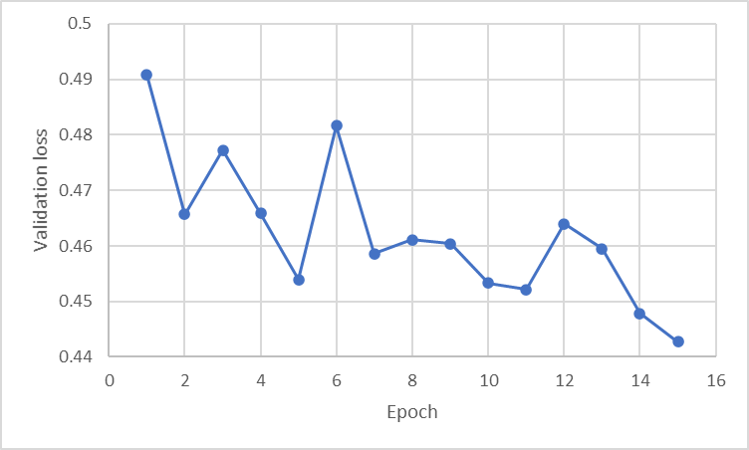
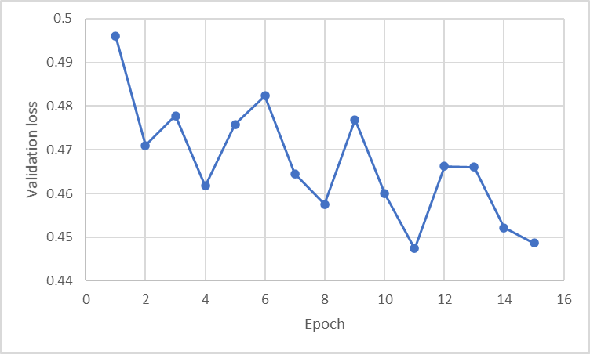
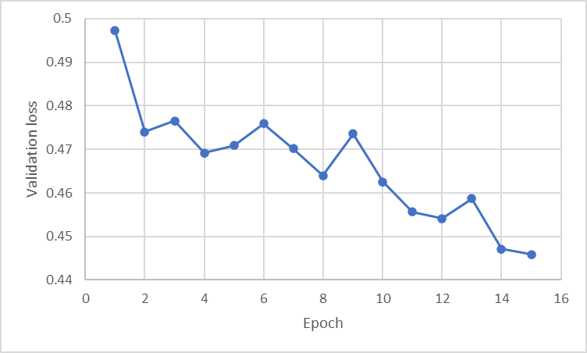
Experiment
batch size = 20
batch size = 30
batch size = 40
Notes:
The validation loss and correct rate in different batch sizes

Slide 7
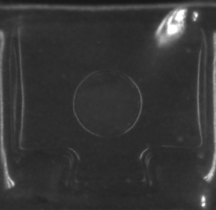
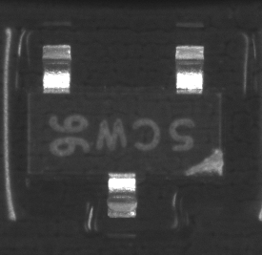
Experiment
The defect semi-conductor that can be detected by pretrained VGG16
The defect semi-conductor that cannot be detected by pretrained VGG16

Slide 8
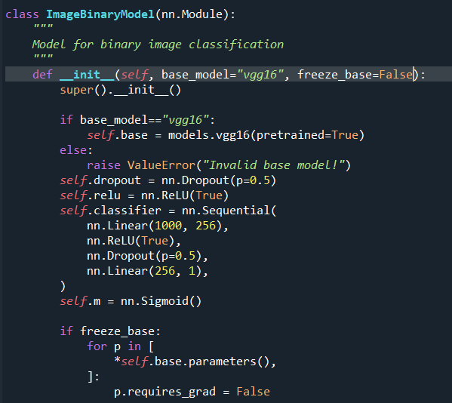
Experiment

Slide 9
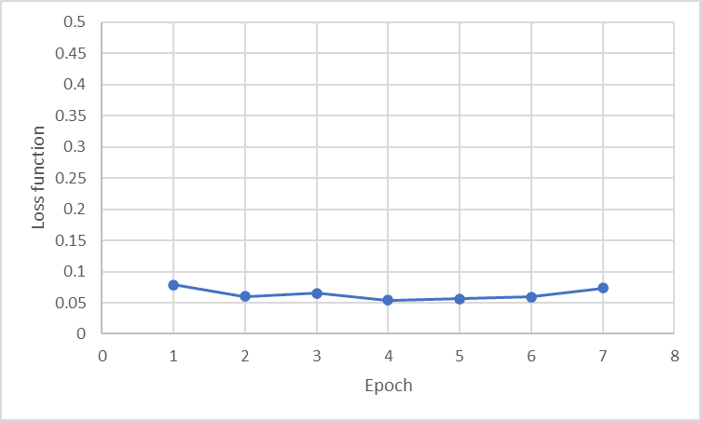
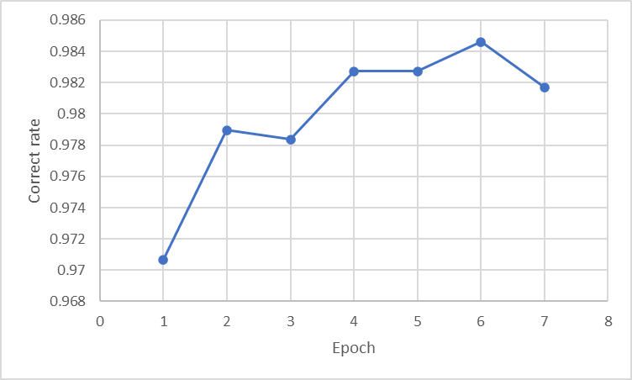
Experiment
Validation loss and correct rate of the model with unfrozen VGG16

Slide 10
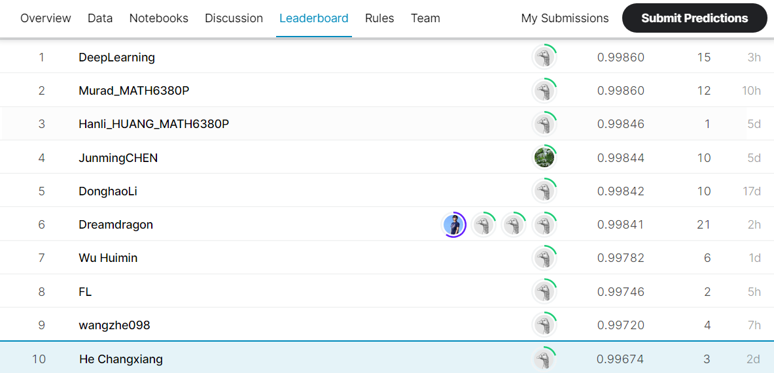
Result

Slide 11
Result
The defect semi-conductors

Slide 12
Thanks!

